Slide 1


TEAM DOMINATERS
AMAZING AI

Slide 2

NATURAL GAS PRICE PREDICTION
DEVELOPED BY:
Venu Chennapai
Saipriya Aitha
Keerthana Muppala
Sumanth Chikka

Slide 3
Table of contents
Introduction
Overview
Advantages and Disadvantages
Applications and future scope

Slide 4
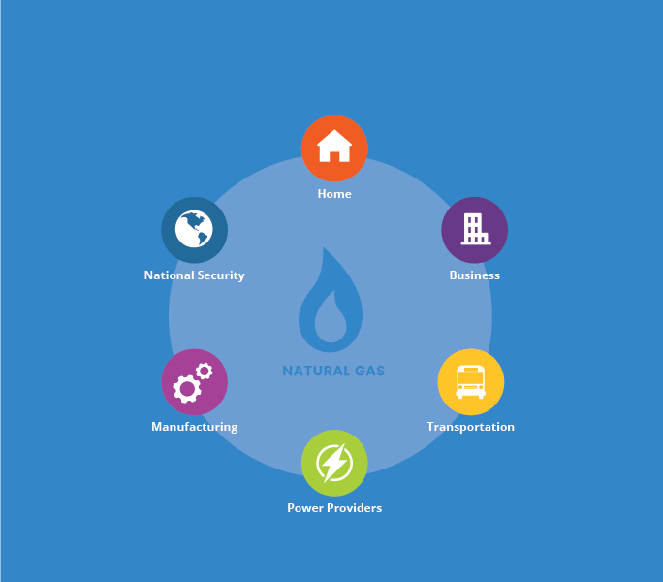
Introduction:
Natural gas has been proposed as a solution to increase the security of energy supply and reduce environmental pollution around the world.
Being able to forecast natural gas price benefits various stakeholders and has become a very valuable tool for all market participants in competitive natural gas markets.
Machine learning algorithms have gradually become popular tools for natural gas price forecasting.

Slide 5
Overview:
To predict the price of natural gas through machine learning we are using algorithms like Svm and Decision Tree Regression.
By applying Svm algorithm we are splitting the dataset.With the help of Decision Tree Regression we are finding the accuracy.
For creating an user interface for prediction we used flask and scripting language Html to create a web page.
This is mainly helpful for stakeholders to predict the prices.

Slide 6
Software Designing
Jupyter Notebook Environment and Google Colab
Spyder Ide
Machine Learning Algorithms
Python (pandas, numpy, matplotlib, seaborn, sklearn)
HTML
Flask

Slide 7
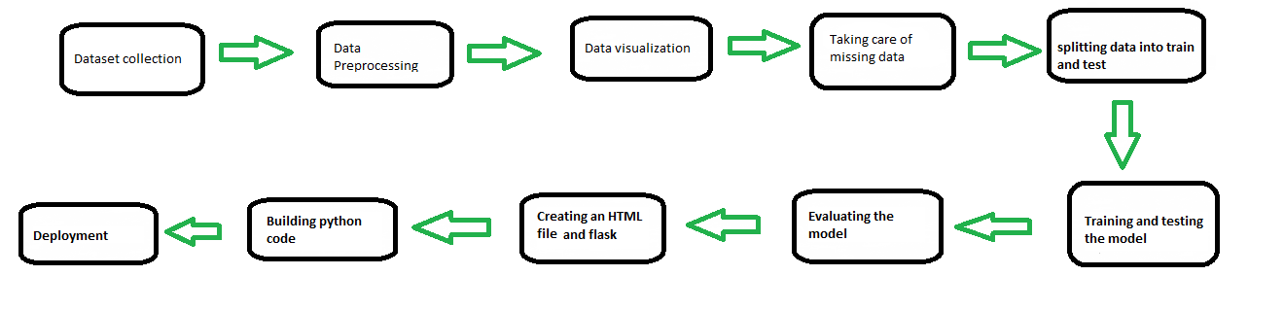
BLOCK DIAGRAM:

Slide 8
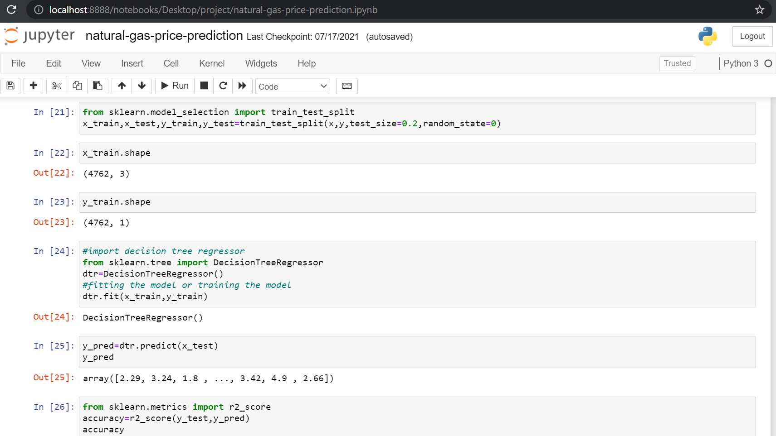

Slide 9
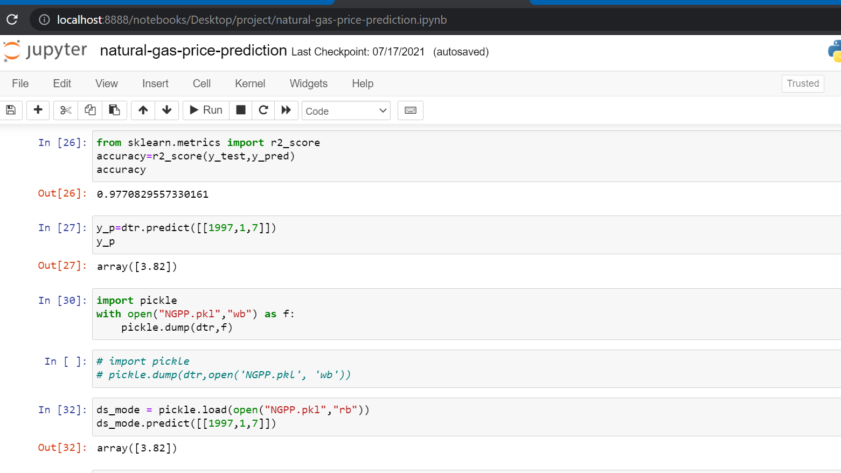

Slide 10
Advantages and Disadvantages:
Advantages:
Disadvantages:
It can work in real time and predicted as soon as the necessary details for prediction are given to the model.
Natural gas price prediction has become a very valuable tool for all market participants in competitive natural gas markets
The natural gas price advantage provides savings your family can count on.
It is composed using the HTML and Python for the web usage in real time
It is used for managing risks in investing in natural gas industry.
It predicts the output within the range but not accurate value.
It could not work anywhere like an web-application, if one is using other should be quiet
It has always been a difficult task to predict the exact daily price
Many factors such as political events, general economic conditions, and traders’ expectations may have an influence on the spot price index.
Gives only 30 % accuracy for the price prediction

Slide 11
Applications:
we can also use this model to predict , different sectors like business, bank, salaries etc...
So we use Machine Learning Algorithms to analyze the data and propose what stakeholders and business companies need to achieve their needs.
Forecast the natural gas price ,benefits various stakeholders and business persons ,whether to buy or invest in natural gas industry with our model

Slide 12
Future Scope:
This Decision Tree Regression model can also be used in the future predictions like weather forecast, job prediction, salary prediction etc.
In future we can create a web application on this type of problems, so that it can be accessed from everywhere with more users.

Slide 13
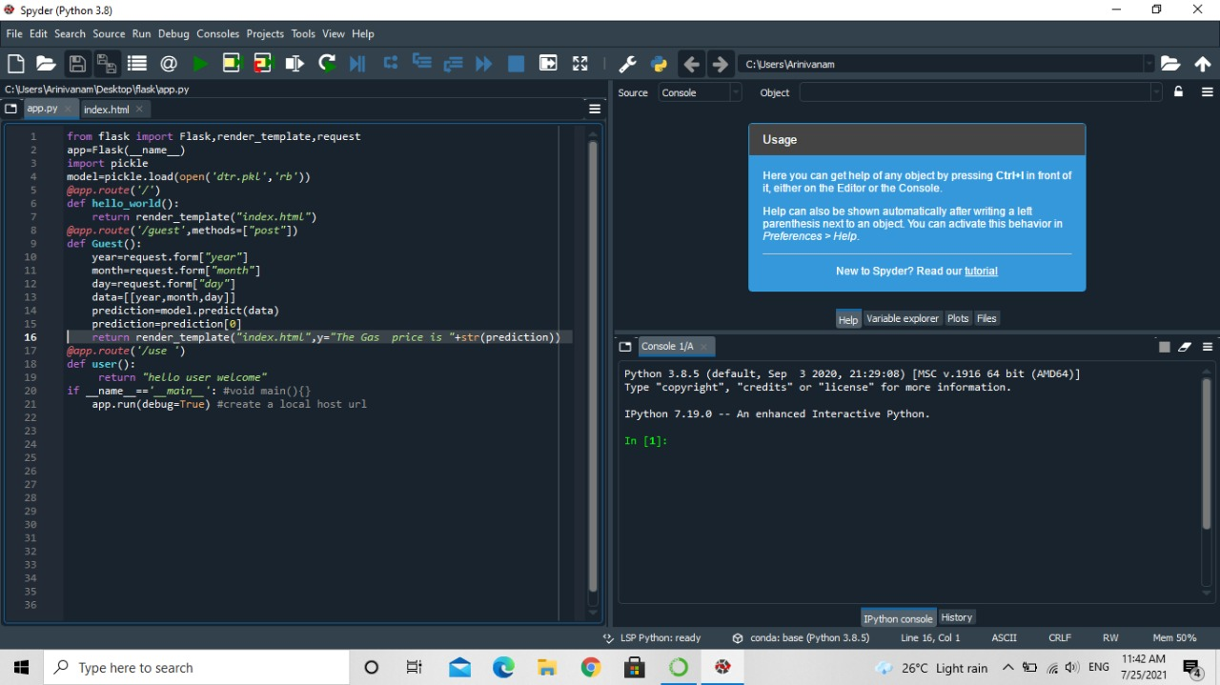

Slide 14
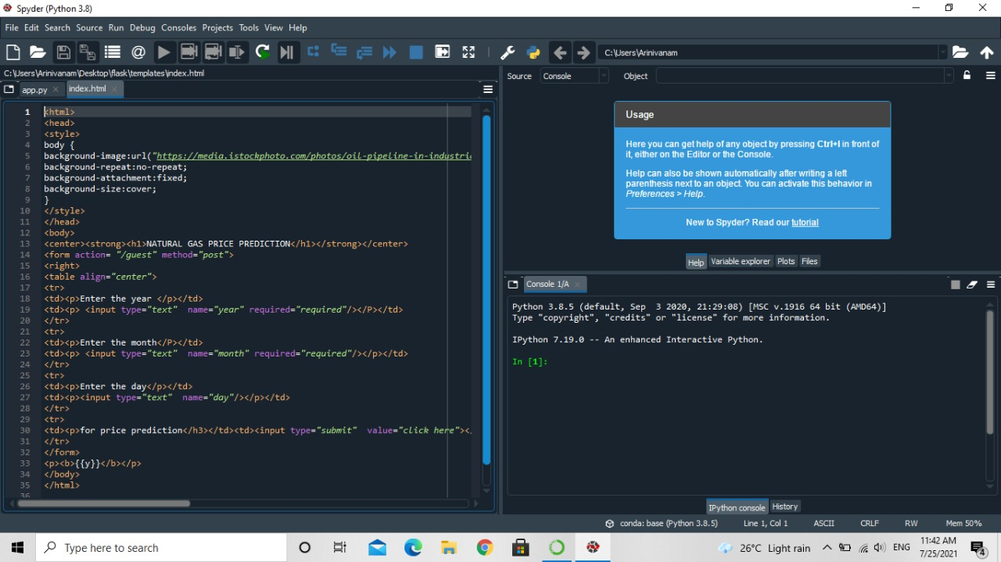

Slide 15
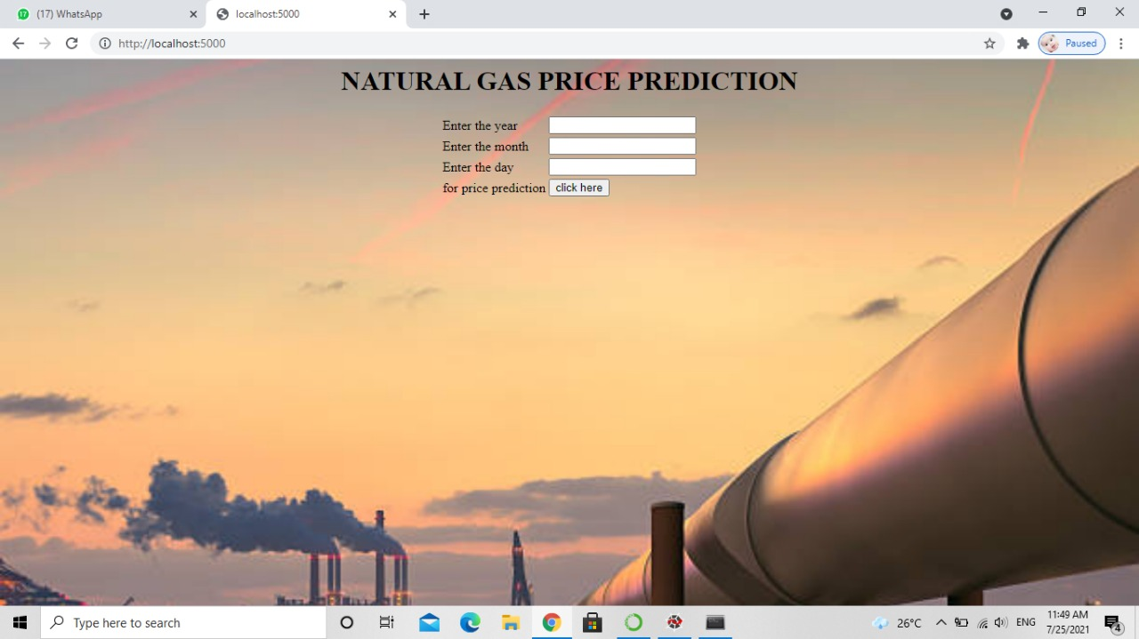

Slide 16
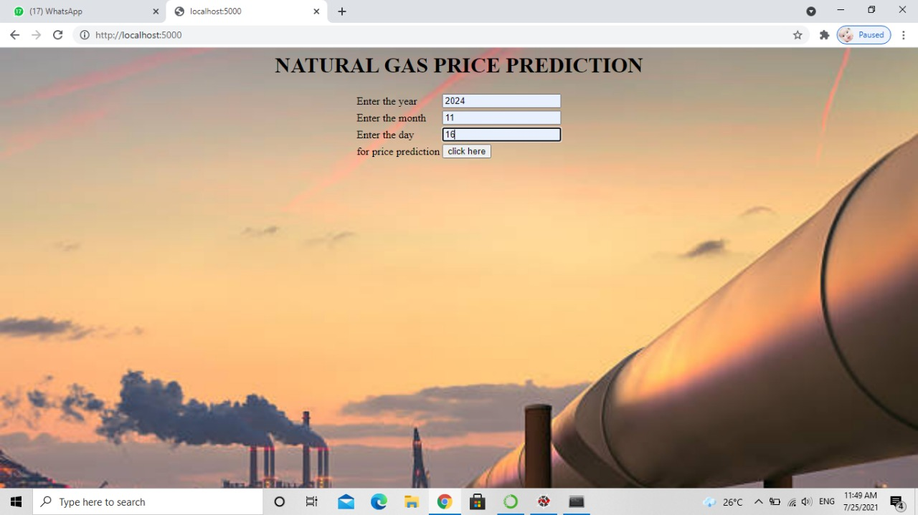

Slide 17
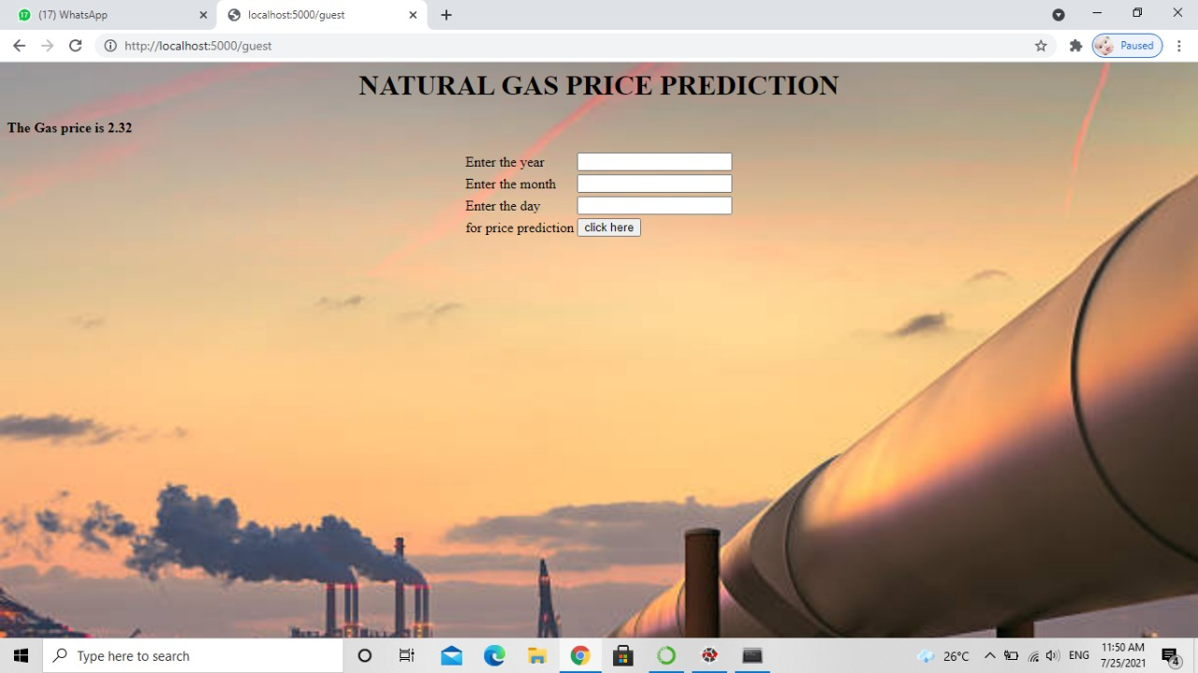

Slide 18

Thank you

